Slide 1

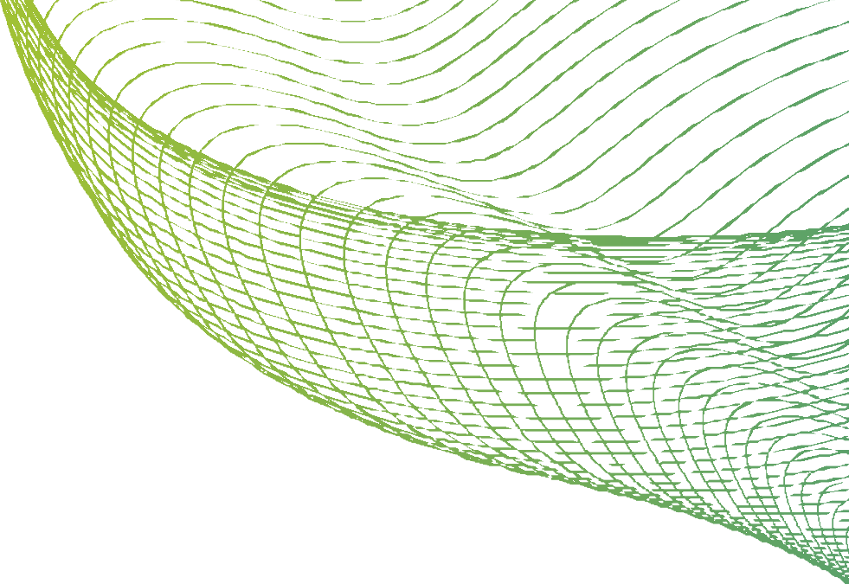


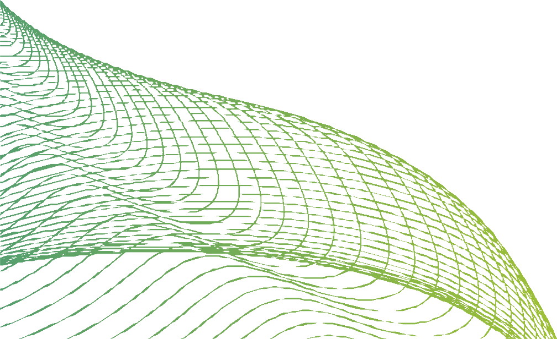
PYTHON SYNTAX

Slide 2
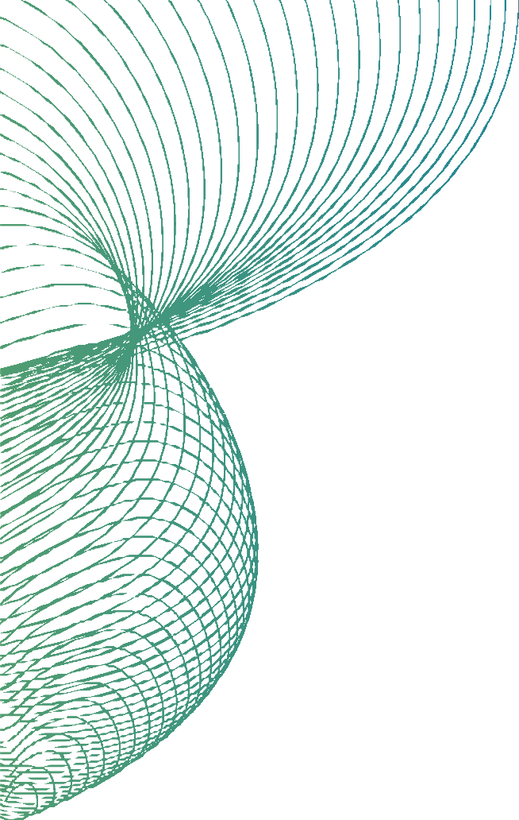
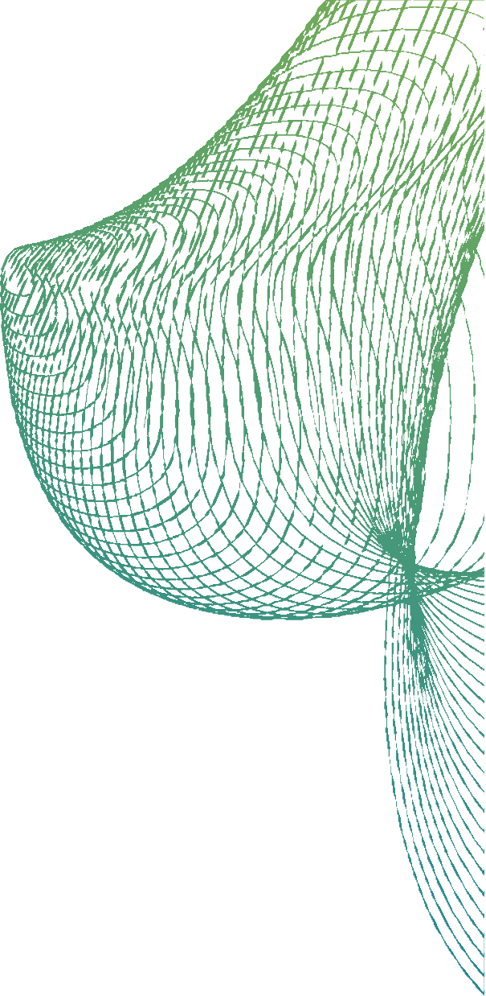
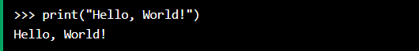

EXECUTE PYTHON SYNTAX
As we learned in the previous page, Python syntax can be executed by writing directly in the Command Line:
Or by creating a python file on the server, using the .py file extension, and running it in the Command Line:

Slide 3

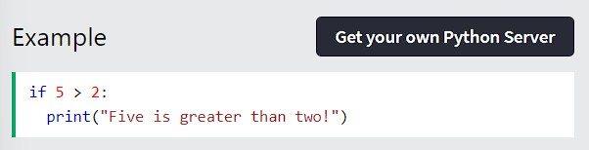
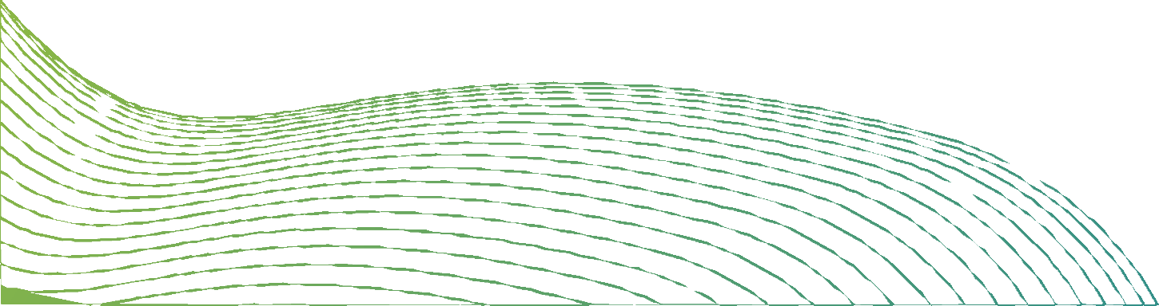
PYTHON INDENTATION
Indentation refers to the spaces at the beginning of a code line. Where in other programming languages the indentation in code is for readability only, the indentation in Python is very important.
Python uses indentation to indicate a block of code.

Slide 4
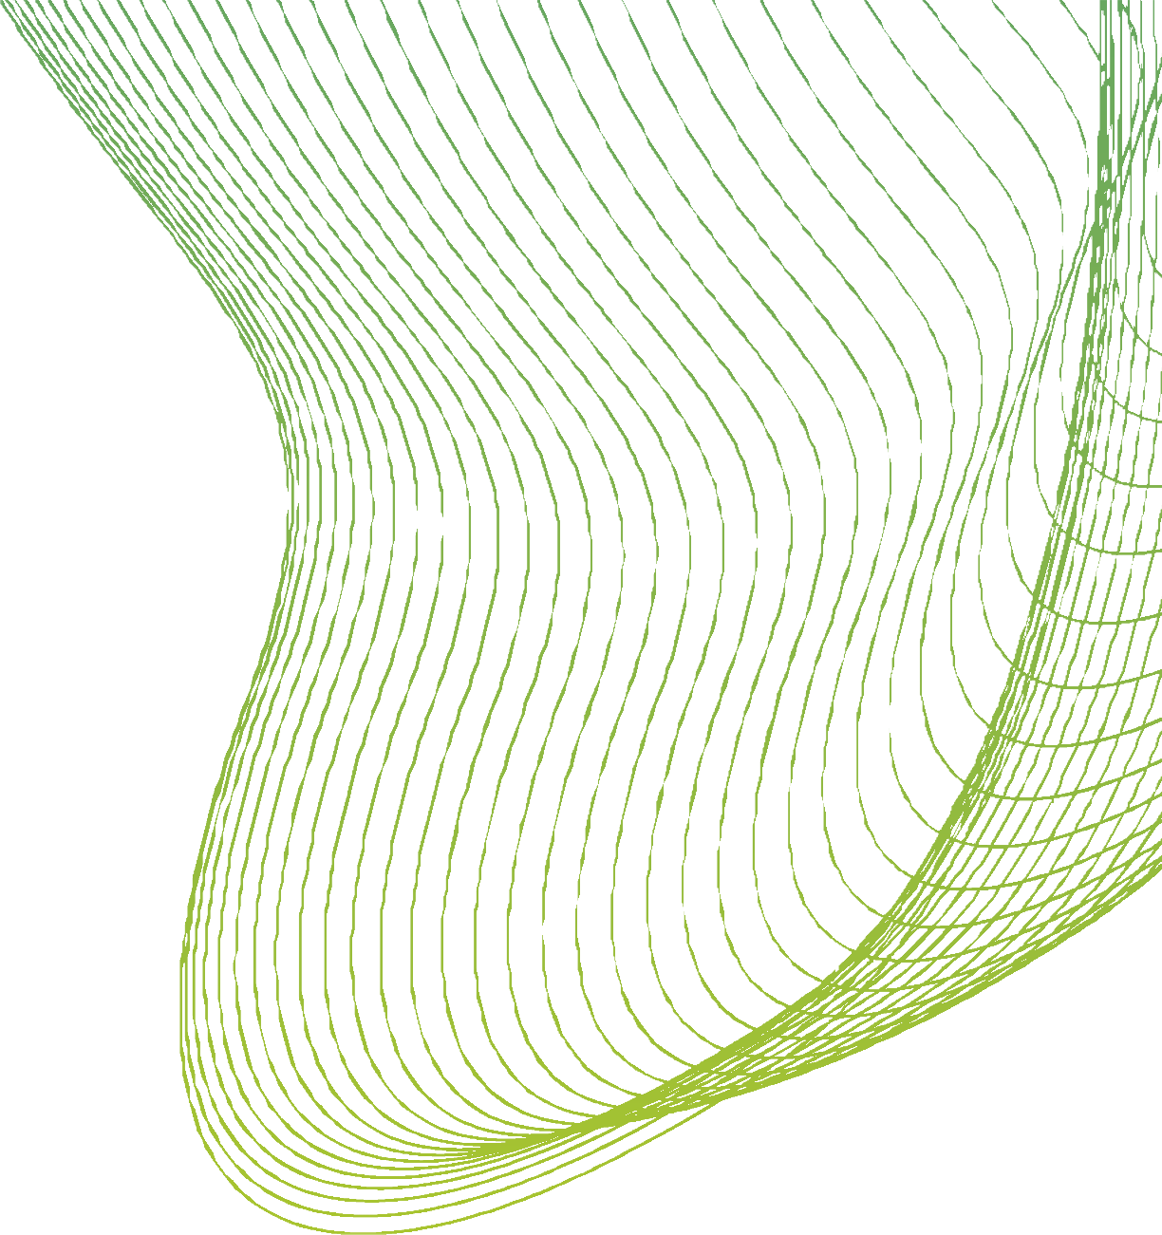
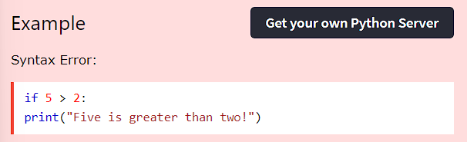
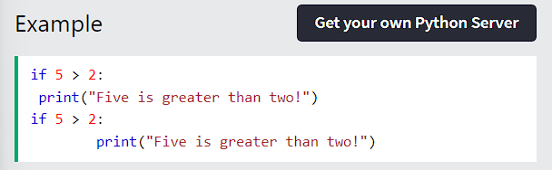
PYTHON INDENTATION
Python will give you an error if you skip the indentation:
The number of spaces is up to you as a programmer, the most common use is four, but it has to be at least one.

Slide 5

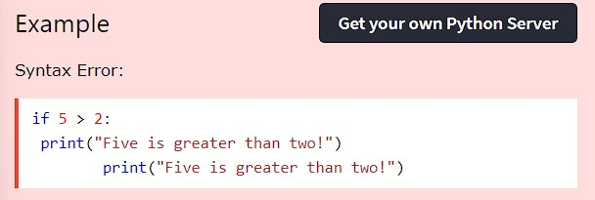

PYTHON INDENTATION
You have to use the same number of spaces in the same block of code, otherwise Python will give you an error:

Slide 6


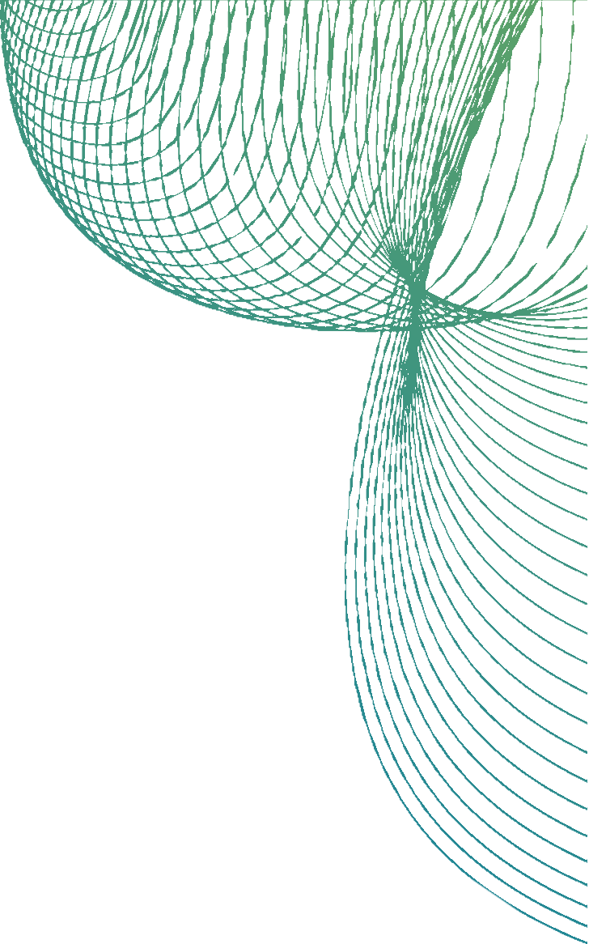
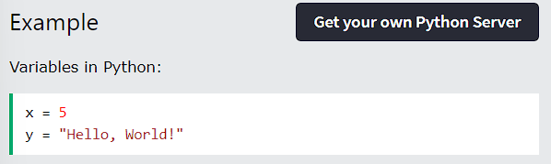
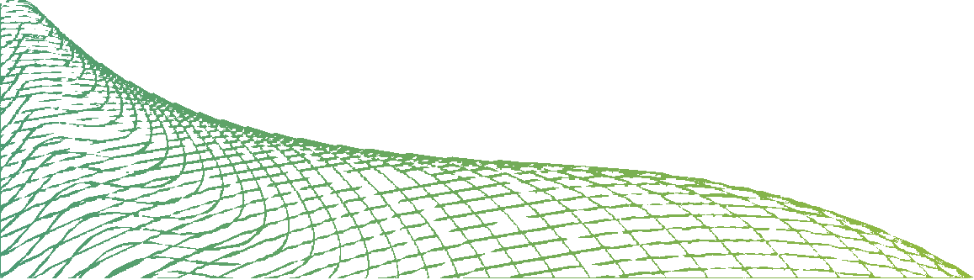
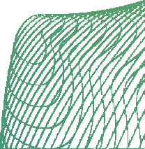
PYTHON VARIABLES
In Python, variables are created when you assign a value to it:
Python has no command for declaring a variable.

Slide 7
COMMENTS
Python has commenting capability for the purpose of in-code documentation. Comments start with a #, and Python will render the rest of the line as a comment:

Slide 8
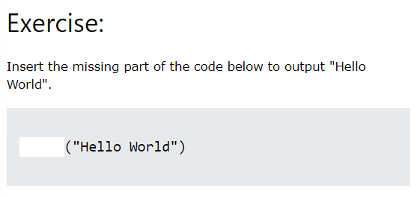
TEST YOURSELF WITH EXERCISES

Slide 9
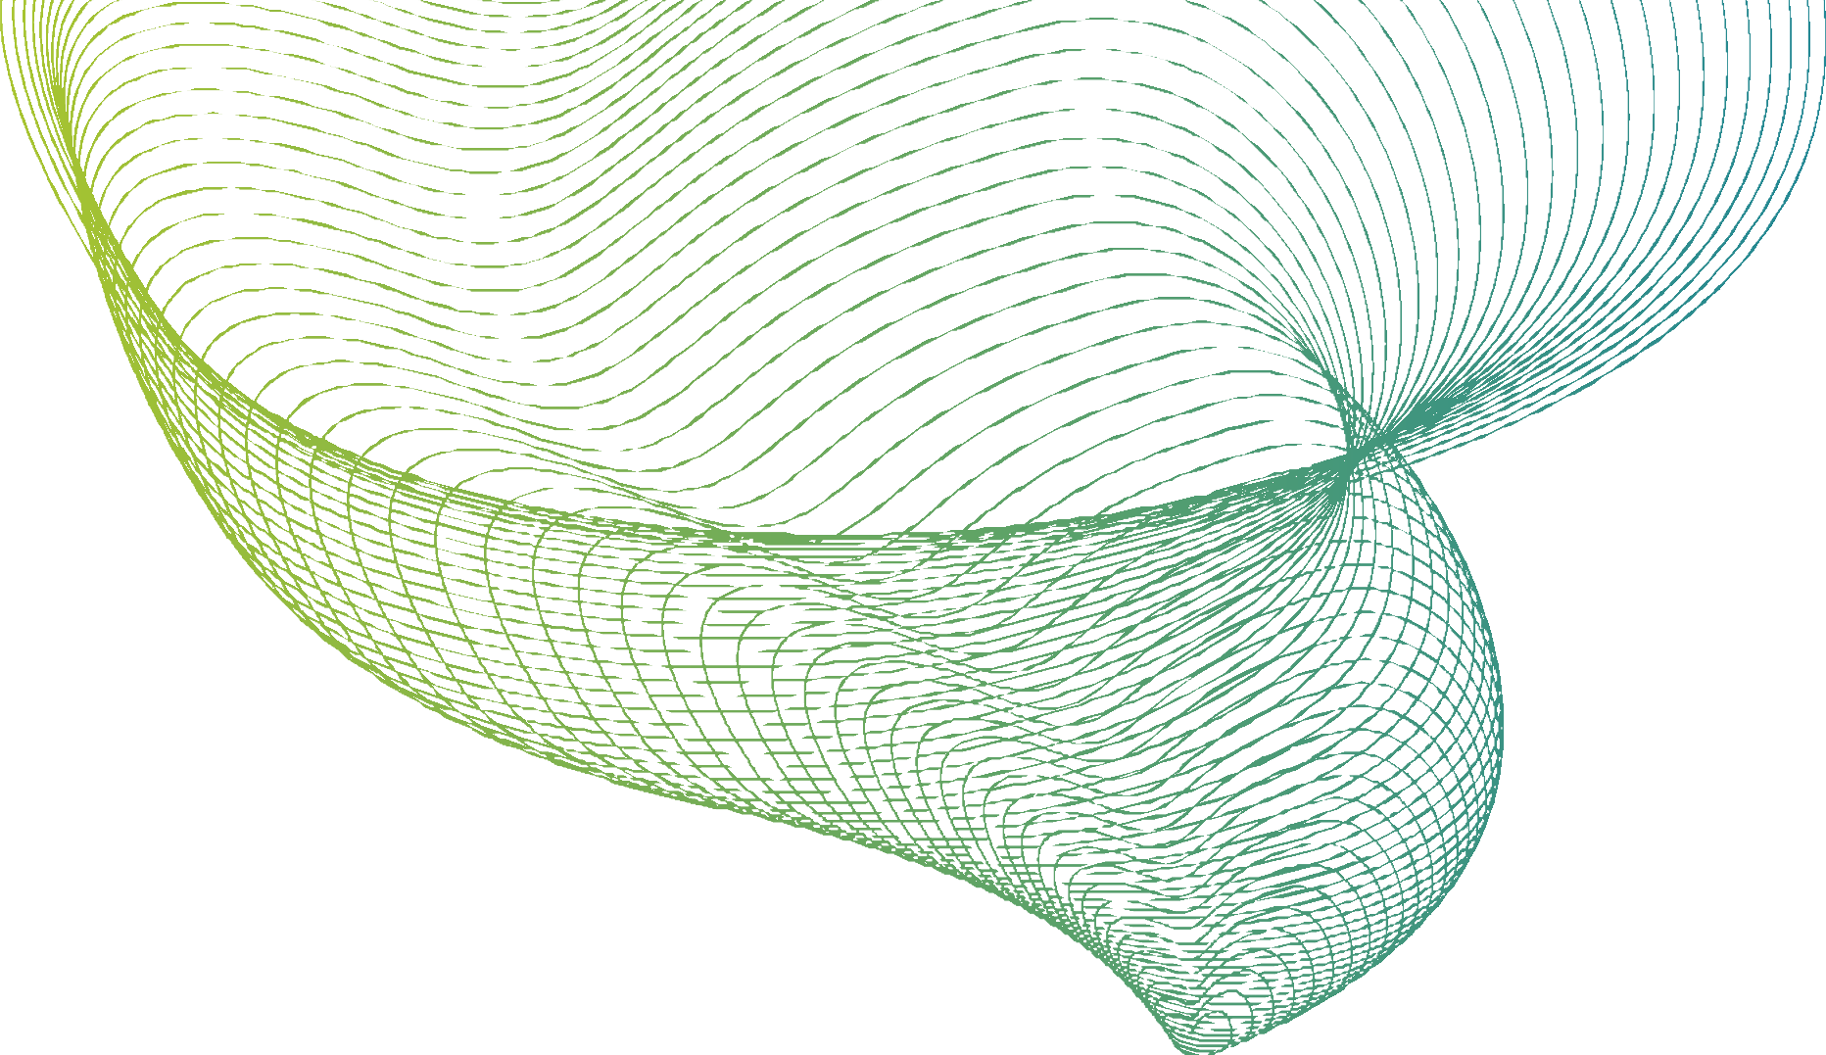

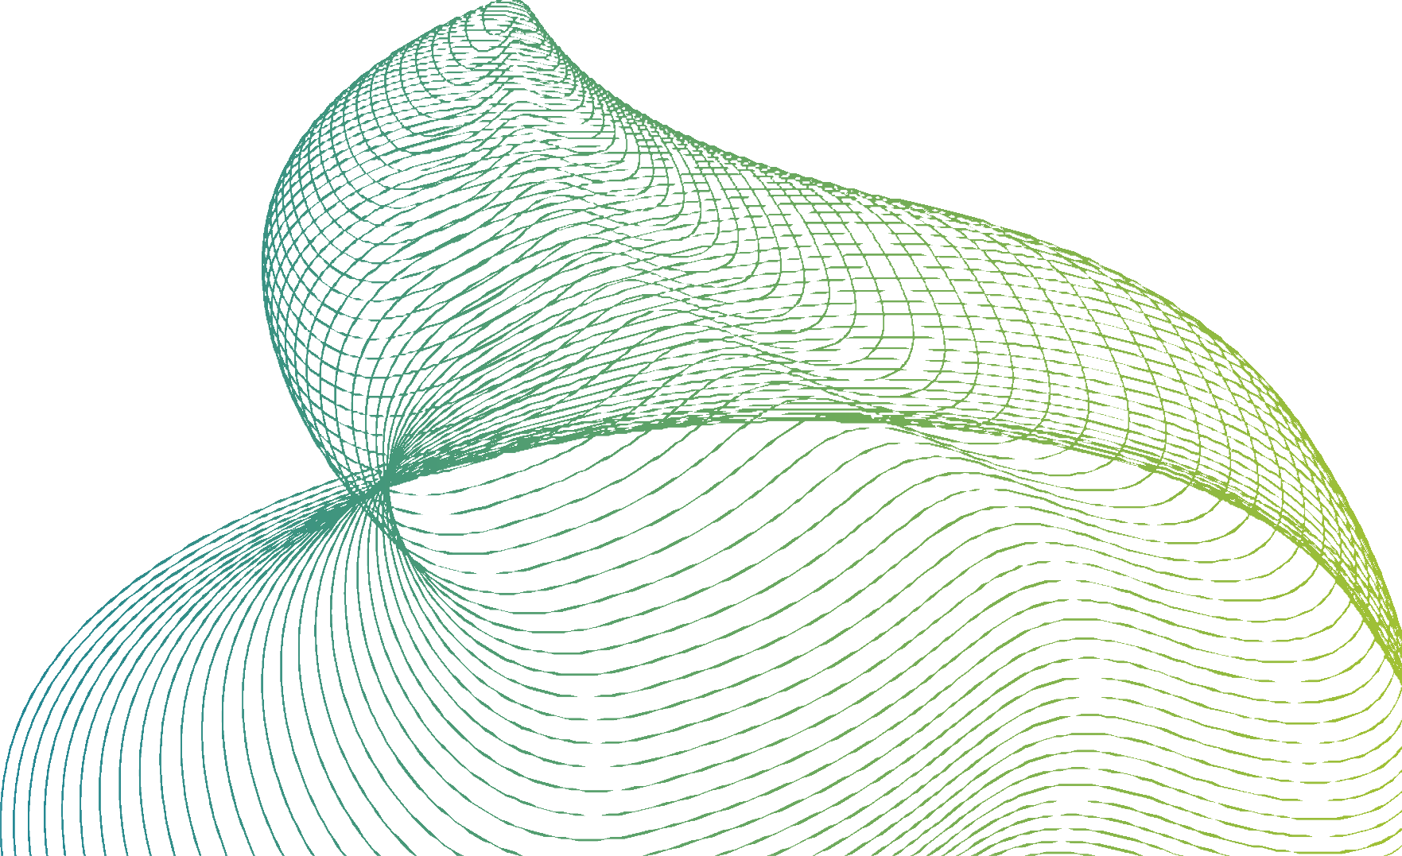
THANK YOU

